Slide 1
DATA SCIENCE
11 WEEK PART TIME COURSE
Week 9 - Time Series
Monday 16th May 2016

Slide 2
AGENDA
Tasks from Monday
Time Series
R
Lab
Advanced Topics
Real World Problem
Review

Slide 3
Task List
Read first 2 chapters of Forecasting Principles and Practice https://www.otexts.org/fpp (15 mins)
Download and Install R (10 mins)
Download and Install RStudio (3 mins)
Download the forecast package in R (2 mins)
DATA SCIENCE - Week 8 Day 2

Slide 4
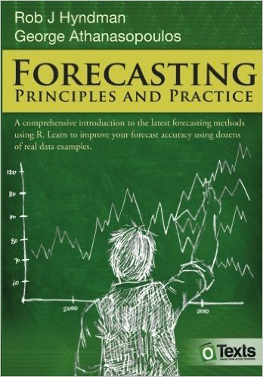
FORECASTING: PRINCIPLES & PRACTICE
1 Getting started
2 The forecaster's toolbox
3 Judgmental forecasts
4 Simple regression
5 Multiple regression
6 Time series decomposition
7 Exponential smoothing
8 ARIMA models
9 Advanced forecasting methods
10 Data
12 Using R

Slide 5
WHAT IS A TIME SERIES?
DATA SCIENCE PART TIME COURSE

Slide 6
WHAT IS A TIME SERIES?
A time series is a series of data that is observed sequentially over time.
Examples include:
Weekly Rainfall
Daily Stock price of Atlassian
Quarterly oil import figures

Slide 7
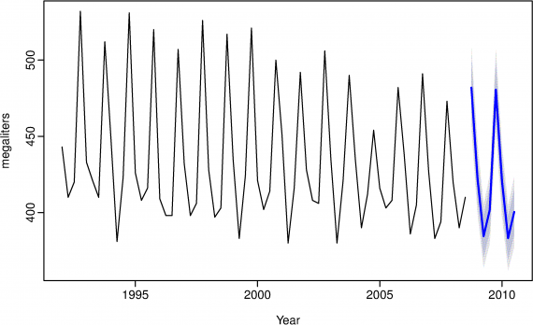
WHAT IS A TIME SERIES?

Slide 8
WHAT MAKES A TIME SERIES DIFFERENT?
In other words, why wouldn’t we just use linear regression and have the time variable as our X values?
y=β0+β1x+ε.

Slide 9
WHAT MAKES A TIME SERIES DIFFERENT?
Recall some of the conditions of Linear Regression models:
have mean zero; otherwise the forecasts will be systematically biased
are not autocorrelated; otherwise the forecasts will be inefficient as there is more information to be exploited in the data
are unrelated to the predictor variable; otherwise there would be more information that should be included in the systematic part of the model

Slide 10
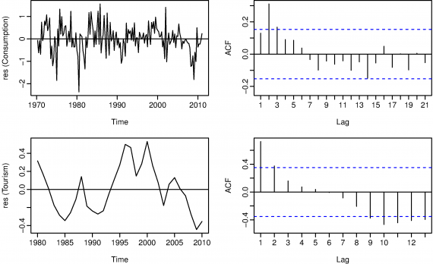
WHAT MAKES A TIME SERIES DIFFERENT?
With time series data it is highly likely that the value of a variable observed in the current time period will be influenced by its value in the previous period, or even the period before that, and so on…

Slide 11
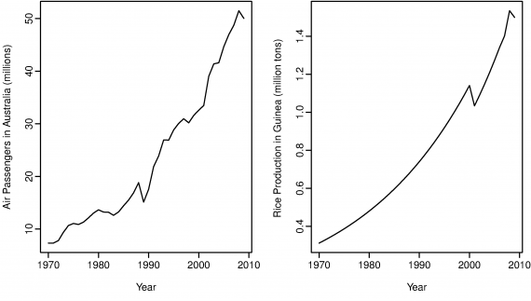
WHAT MAKES A TIME SERIES DIFFERENT?
Time Series will often be ‘non-stationary’, that means that you do not have a zero mean or constant variance. This can lead to spurious regressors (factors considered influential in a model that are actually not).

Slide 12
TIME SERIES COMPONENTS
There are three time series components we will use to describe a time series
Trend
Seasonal
Cyclic

Slide 13
TIME SERIES COMPONENTS - TREND
A trend exists when there is a long-term increase or decrease in the data. It does not have to be linear. Sometimes we will refer to a trend “changing direction” when it might go from an increasing trend to a decreasing trend.

Slide 14
TIME SERIES COMPONENTS - SEASONAL
A seasonal pattern exists when a series is influenced by seasonal factors (e.g., the quarter of the year, the month, or day of the week). Seasonality is always of a fixed and known period.

Slide 15
TIME SERIES COMPONENTS - CYCLIC
A cyclic pattern exists when data exhibit rises and falls that are not of fixed period. The duration of these fluctuations is usually of at least 2 years.

Slide 16
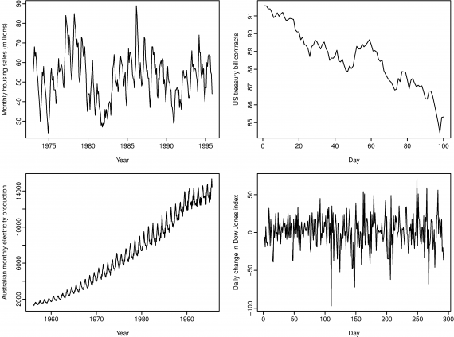

Slide 17
TIME SERIES COMPONENTS
Top Left: strong seasonality within each year, as well as some strong cyclic behaviour with period about 6–10 years. No Trend
Top Right: no seasonality, but an obvious downward trend. If we had more data we may be able to observe a cycle
Bottom Left: strong increasing trend, with strong seasonality. No cycle
Bottom Right: no trend, seasonality or cyclic behaviour

Slide 18
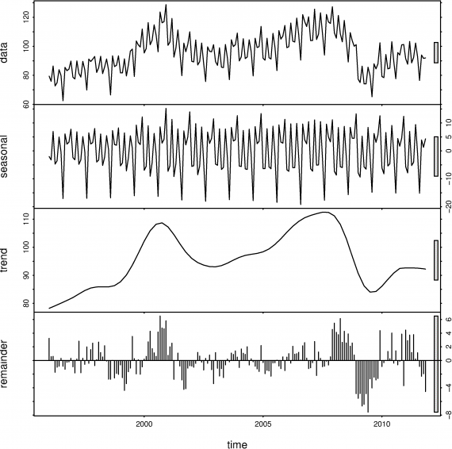
WHAT IS A TIME SERIES DECOMPOSITION?
Time Series Decomposition is a way to break down a time series into the Season, Trend (which includes the cycle) and Remainder.

Slide 19
TIME SERIES MODELS - EXPONENTIAL SMOOTHING
We can consider these to be weighted averages of past observations. This means that the more recent the observation, the higher the weighting of that observation.
The Naive model is the case where the forecast is equal to the last observed value,
ŷ T+h|T=yT
What if we were to weight the observations to have decreasing weights as the observations got older? What would the equation look like?

Slide 20
TIME SERIES MODELS - EXPONENTIAL SMOOTHING
ŷ T+1|T=αyT+α(1−α)yT-1+α(1−α)²yT-2+⋯
where 0 ≤ α ≤ 1 is the smoothing parameter.

Slide 21
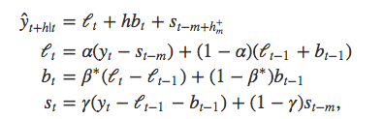
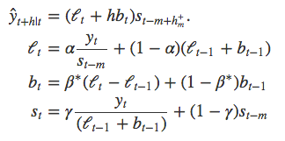
TIME SERIES MODELS - HOLT WINTERS
The Holt-Winters method captures level, trend and seasonality.
There are two variations to this method that differ in the nature of the seasonal component. The additive method is preferred when the seasonal variations are roughly constant through the series, while the multiplicative method is preferred when the seasonal variations are changing proportional to the level of the series.

Slide 22
ARIMA MODELS - STATIONARITY & DIFFERENCING
A stationary time series is one whose properties do not depend on the time at which the series is observed. So time series with trends, or with seasonality, are not stationary — the trend and seasonality will affect the value of the time series at different times. On the other hand, a white noise series is stationary — it does not matter when you observe it, it should look much the same at any period of time.
In general, a stationary time series will have no predictable patterns in the long-term. Time plots will show the series to be roughly horizontal (although some cyclic behaviour is possible) with constant variance.

Slide 23
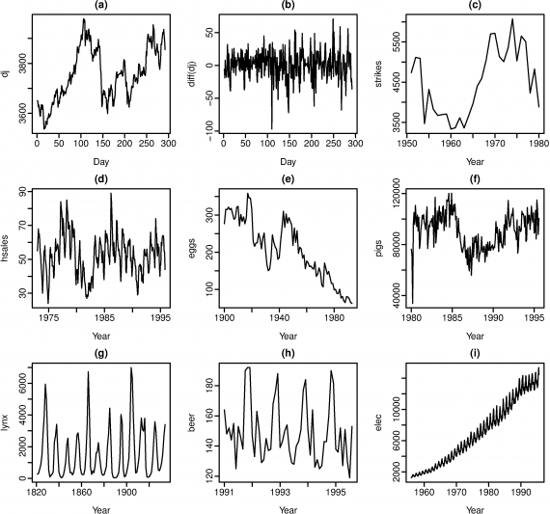

Slide 24
ARIMA MODELS - STATIONARITY & DIFFERENCING
seasonality rules out series (d), (h) and (i).
Trend rules out series (a), (c), (e), (f) and (i).
Increasing variance also rules out (i).
That leaves only (b) and (g) as stationary series. At first glance, the strong cycles in series (g) might appear to make it non-stationary. But these cycles are aperiodic

Slide 25
ARIMA MODELS - STATIONARITY & DIFFERENCING
One way to make a time series stationary is to compute the differences between consecutive observations.
Differencing can help stabilize the mean of a time series by removing changes in the level of a time series, and so eliminating trend and seasonality.
A seasonal difference is the difference between an observation and the corresponding observation from the previous year

Slide 26
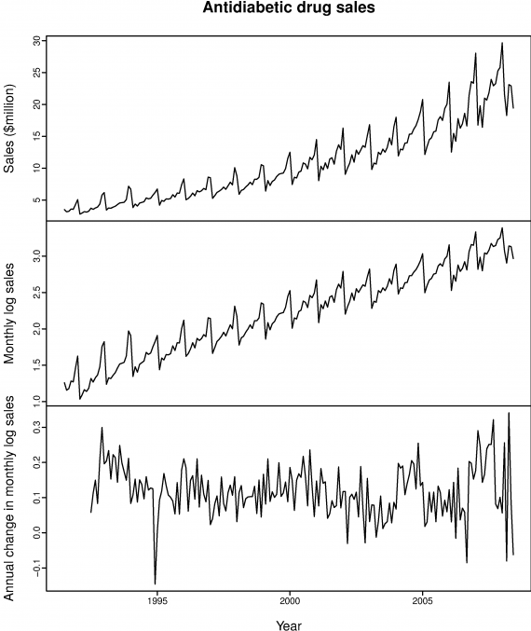

Slide 27
ARIMA MODELS - BACKSHIFT OPERATOR
The backward shift operator BB is a useful notational device when working with time series lags:
Byt=yt-1
Two applications of BB to yt shifts the data back two periods:
B(Byt)=B²yt=yt-2
(This is also known as a Lag operator)

Slide 28
ARIMA MODELS - AUTOREGRESSIVE (AR)
In an autoregression model, we forecast the variable of interest using a linear combination of past values of the variable. The term autoregression indicates that it is a regression of the variable against itself.
This is like a multiple regression but with lagged values of yt as predictors. We refer to this as an AR(p) model

Slide 29
ARIMA MODELS - MOVING AVERAGE (MA)
Rather than use past values of the forecast variable in a regression, a moving average model uses past forecast errors in a regression-like model.
We refer to this as an MA(q) model

Slide 30
ARIMA MODELS - PUTTING IT ALL TOGETHER
If we combine differencing with autoregression and a moving average model, we obtain a non-seasonal ARIMA model. ARIMA is an acronym for AutoRegressive Integrated Moving Average model (“integration” in this context is the reverse of differencing).
We call this an ARIMA(p,d,q) model, where
p= order of the autoregressive part;
d= degree of first differencing involved;
q= order of the moving average part.

Slide 31

EVALUATING A TIME SERIES MODEL
The forecast error is simply ei=yi−ŷi, which is on the same scale as the data. Accuracy measures that are based on ei are therefore scale-dependent and cannot be used to make comparisons between series that are on different scales.

Slide 32
EVALUATING A TIME SERIES MODEL
The percentage error is given by pi=100ei/yi. Percentage errors have the advantage of being scale-independent, and so are frequently used to compare forecast performance between different data sets.
Mean absolute percentage error: MAPE=mean(|pi|)

Slide 33
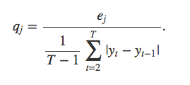
EVALUATING A TIME SERIES MODEL
Scaled errors are an alternative to using percentage errors when comparing forecast accuracy across series on different scales. They proposed scaling the errors based on the training MAE from a simple forecast method. For a non-seasonal time series, a useful way to define a scaled error uses naïve forecasts:
A scaled error is less than one if it arises from a better forecast than the average naïve forecast computed on the training data.

Slide 34
CROSS-VALIDATION FOR TIME SERIES
The three parameters for this type of splitting in the R Caret package are:
initialWindow: the initial number of consecutive values in each training set sample
horizon: The number of consecutive values in test set sample
fixedWindow: A logical: if FALSE, the training set always start at the first sample and the training set size will vary over data splits.

Slide 35
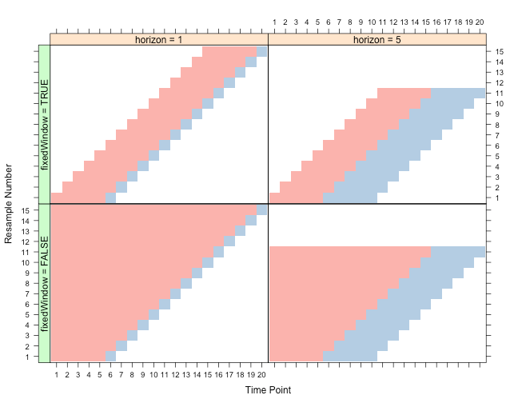

Slide 36

DATA SCIENCE PART TIME COURSE

Slide 37
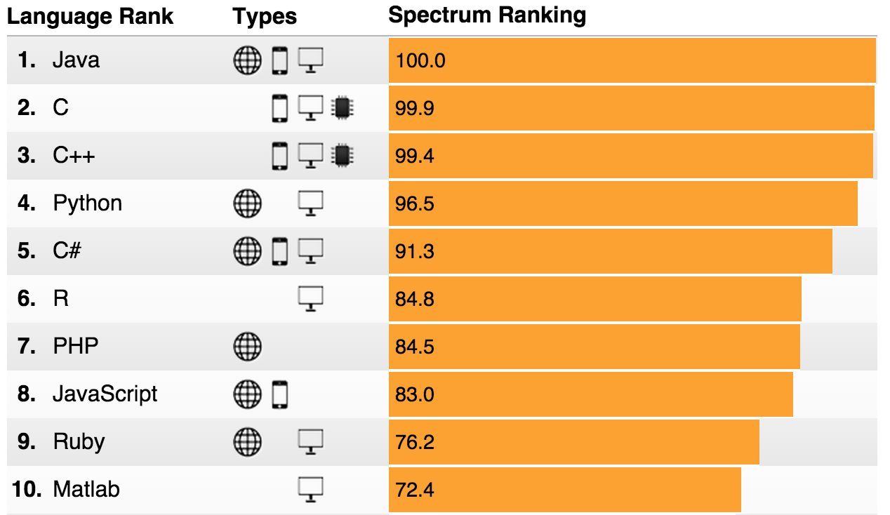
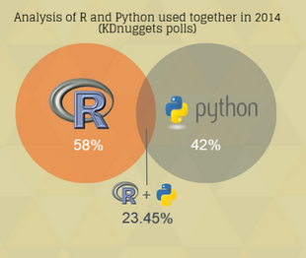
PYTHON & R
IEEE Spectrum Survey 2015
DataCamp Infographic 2015

Slide 38
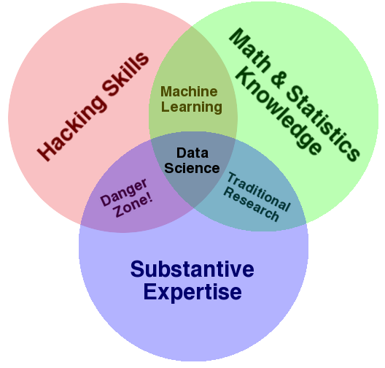


PYTHON & R

Slide 39
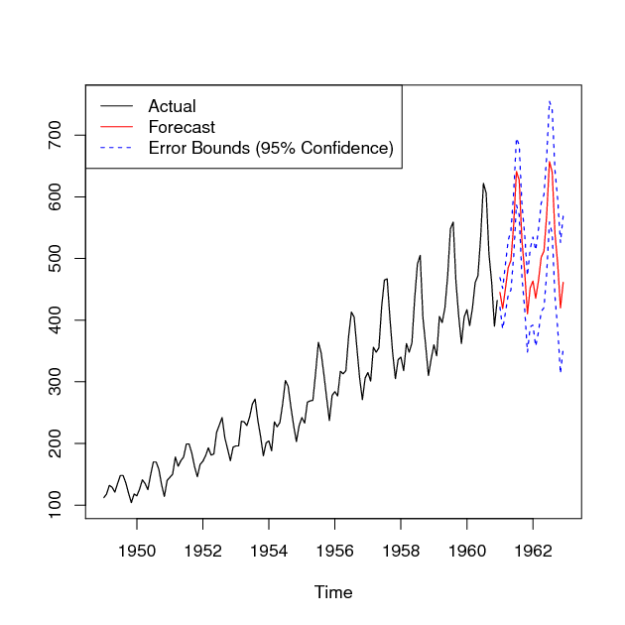
LAB
DATA SCIENCE PART TIME COURSE

Slide 40
ADVANCED TOPICS
Recurrent Neural Networks (RNNs)
Clustering Time Series
Hierarchical Time Series
Bayesian Structural Time Series
Causal Impact
Outlier Analysis

Slide 41
DISCUSSION TIME
Talk through a real problem
Review
Questions
Task List
DATA SCIENCE - Week 8 Day 2

Slide 42


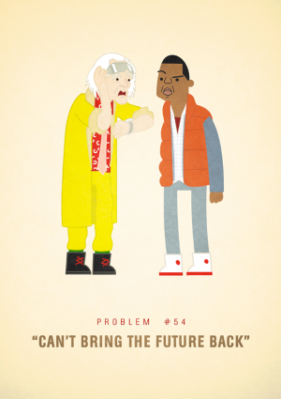
REAL PROBLEMS
DATA SCIENCE - Week 8 Day 2

Slide 43
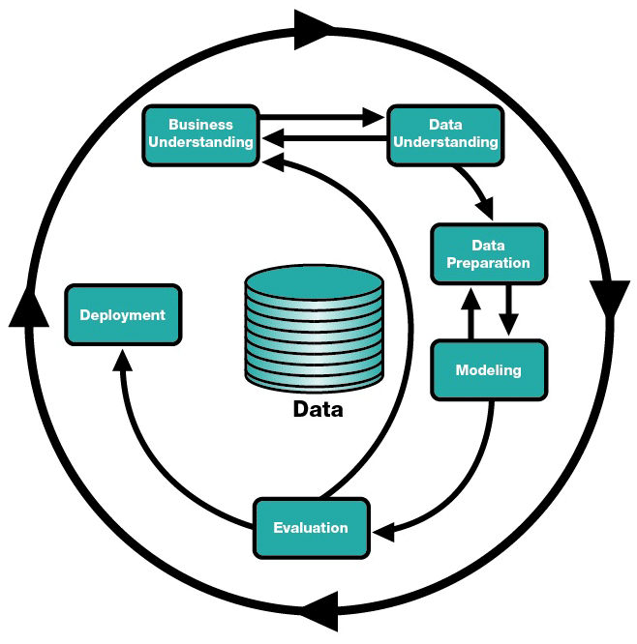
DATA SCIENCE - Week 8 Day 2

